Slide 1
Exploding Kittens
Oscar, Jacob, Sara

Slide 2
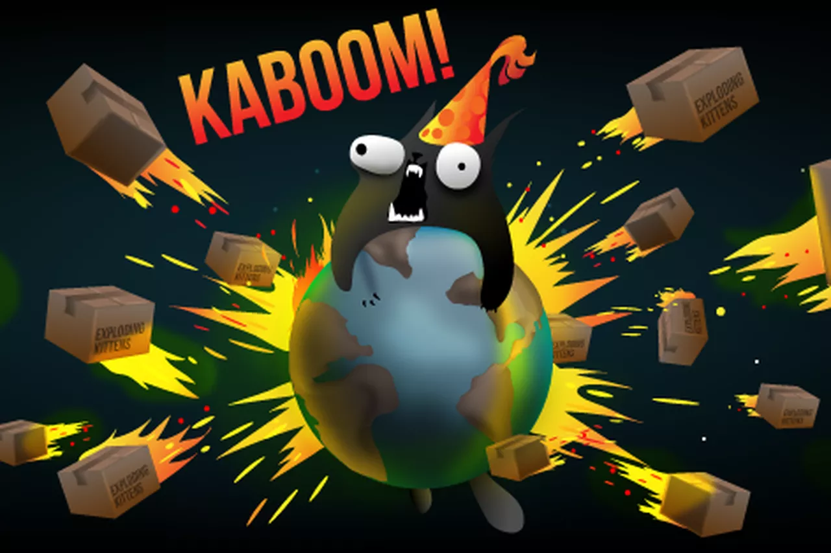
What is Exploding Kittens?
A card game with a cat theme in which players try to avoid drawing the exploding kitten without a defuse card.
One way to think of it is as a combination of “Go Fish” and “Old Maid.”
http://www.explodingkittens.com/how

Slide 3
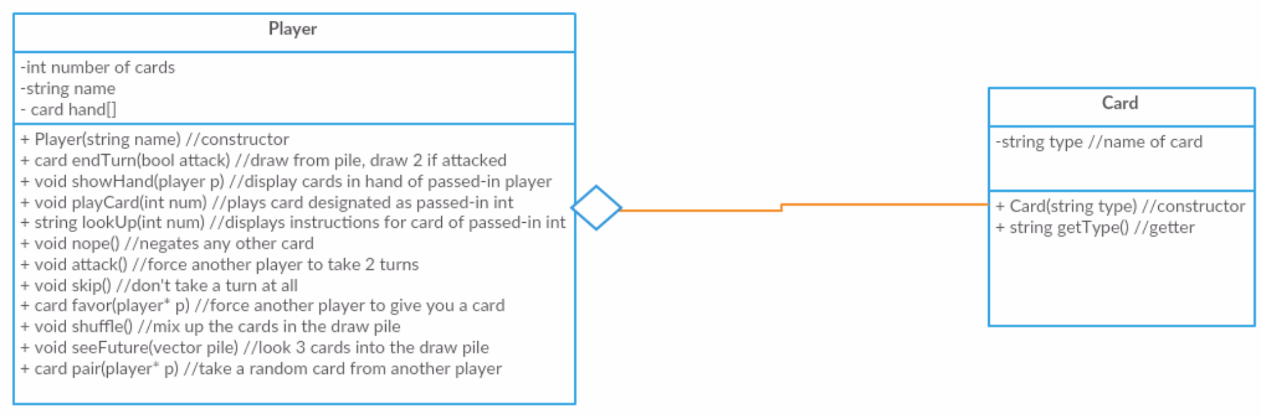
The UML (original)

Slide 4
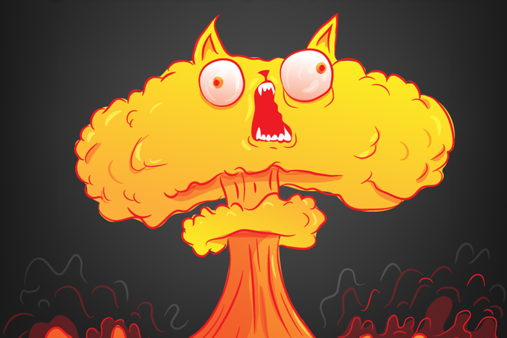
Assigning Classes
Card Class
Adds Card Types
Player Class
Creates the players
Creates the Card functions between players

Slide 5
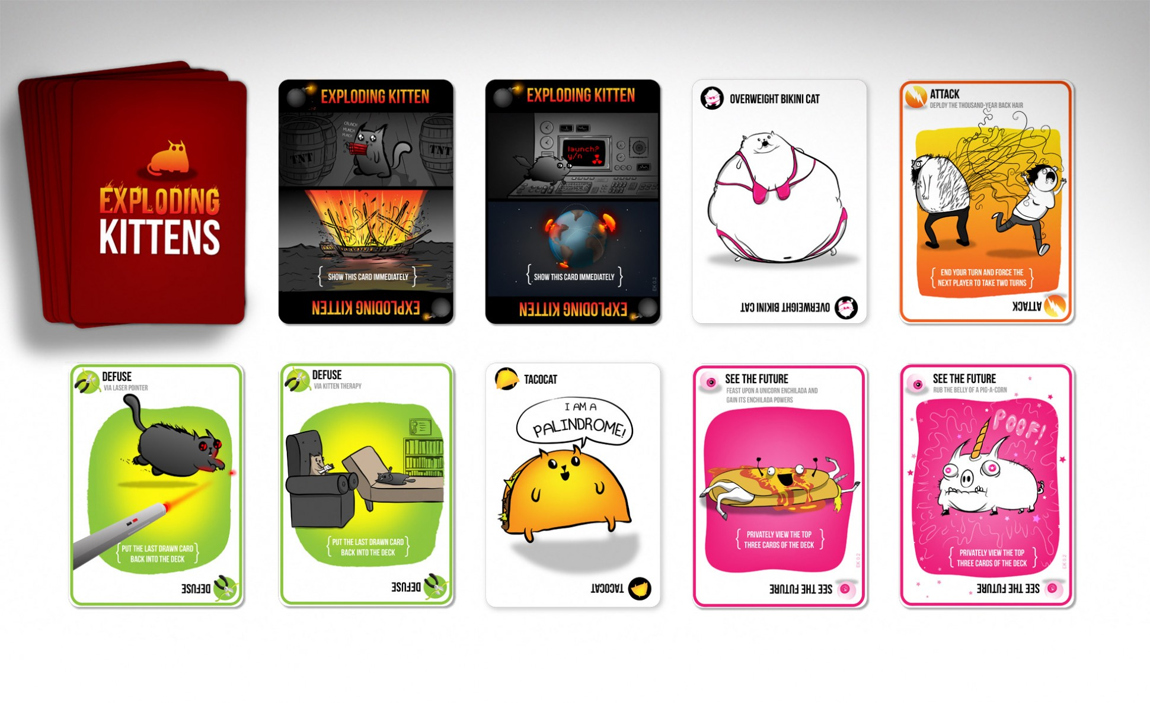
Functions
Card Functions
Exploding Kittens
Defuse
Attack
See the Future
“Cat Cards” – Pairs

Slide 6
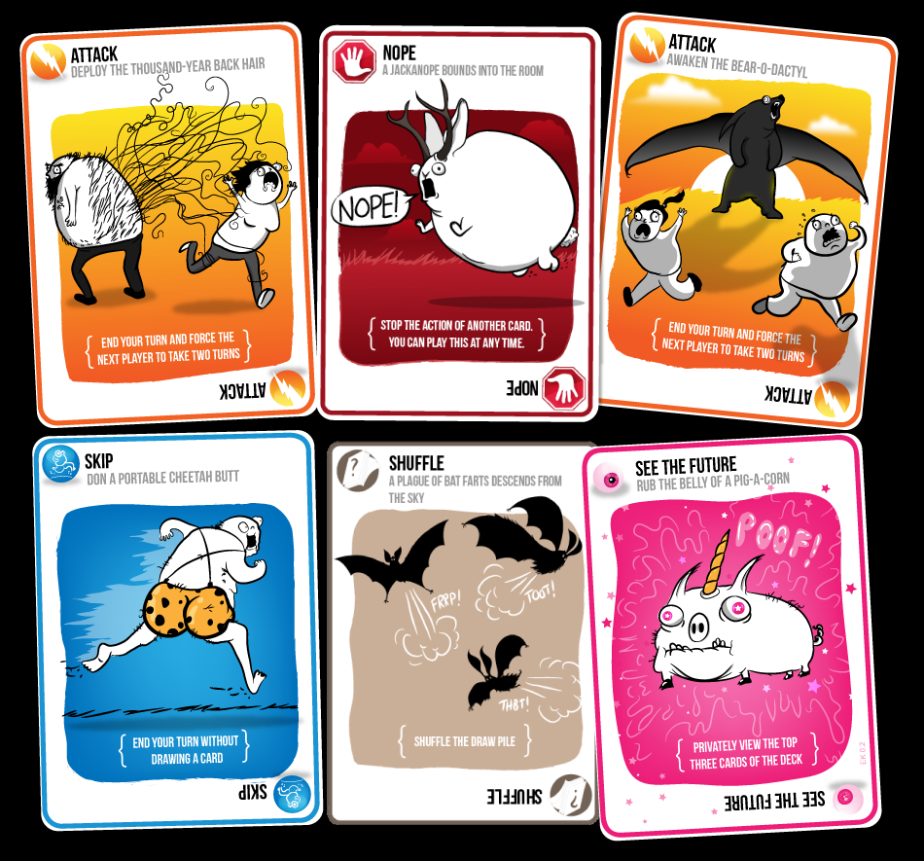
Functions Cont.
Nope
Skip
Shuffle
Favor

Slide 7
The Demo!
Go to Visual Studios

